Slide 1
CookSmart
Photo To Recipe Using Machine Learning

Slide 2
An Uncomfortable Truth
In 2021 Ireland generated over 750,000 tonnes of food waste
120kg per household, 44 kg per person
Costs the average household €60 per month
Costs the nation €1.29 Billion
Government aims to reduce this by 50% by 2030
Source : Agency EP. Food Waste Statistics

Slide 3
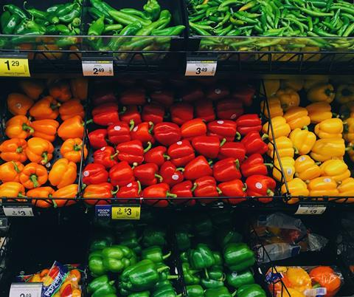
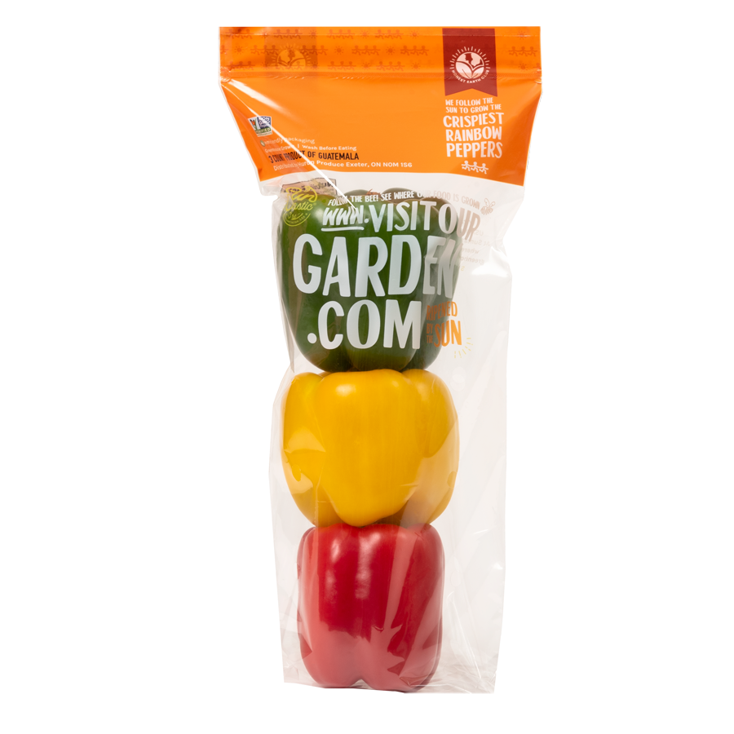
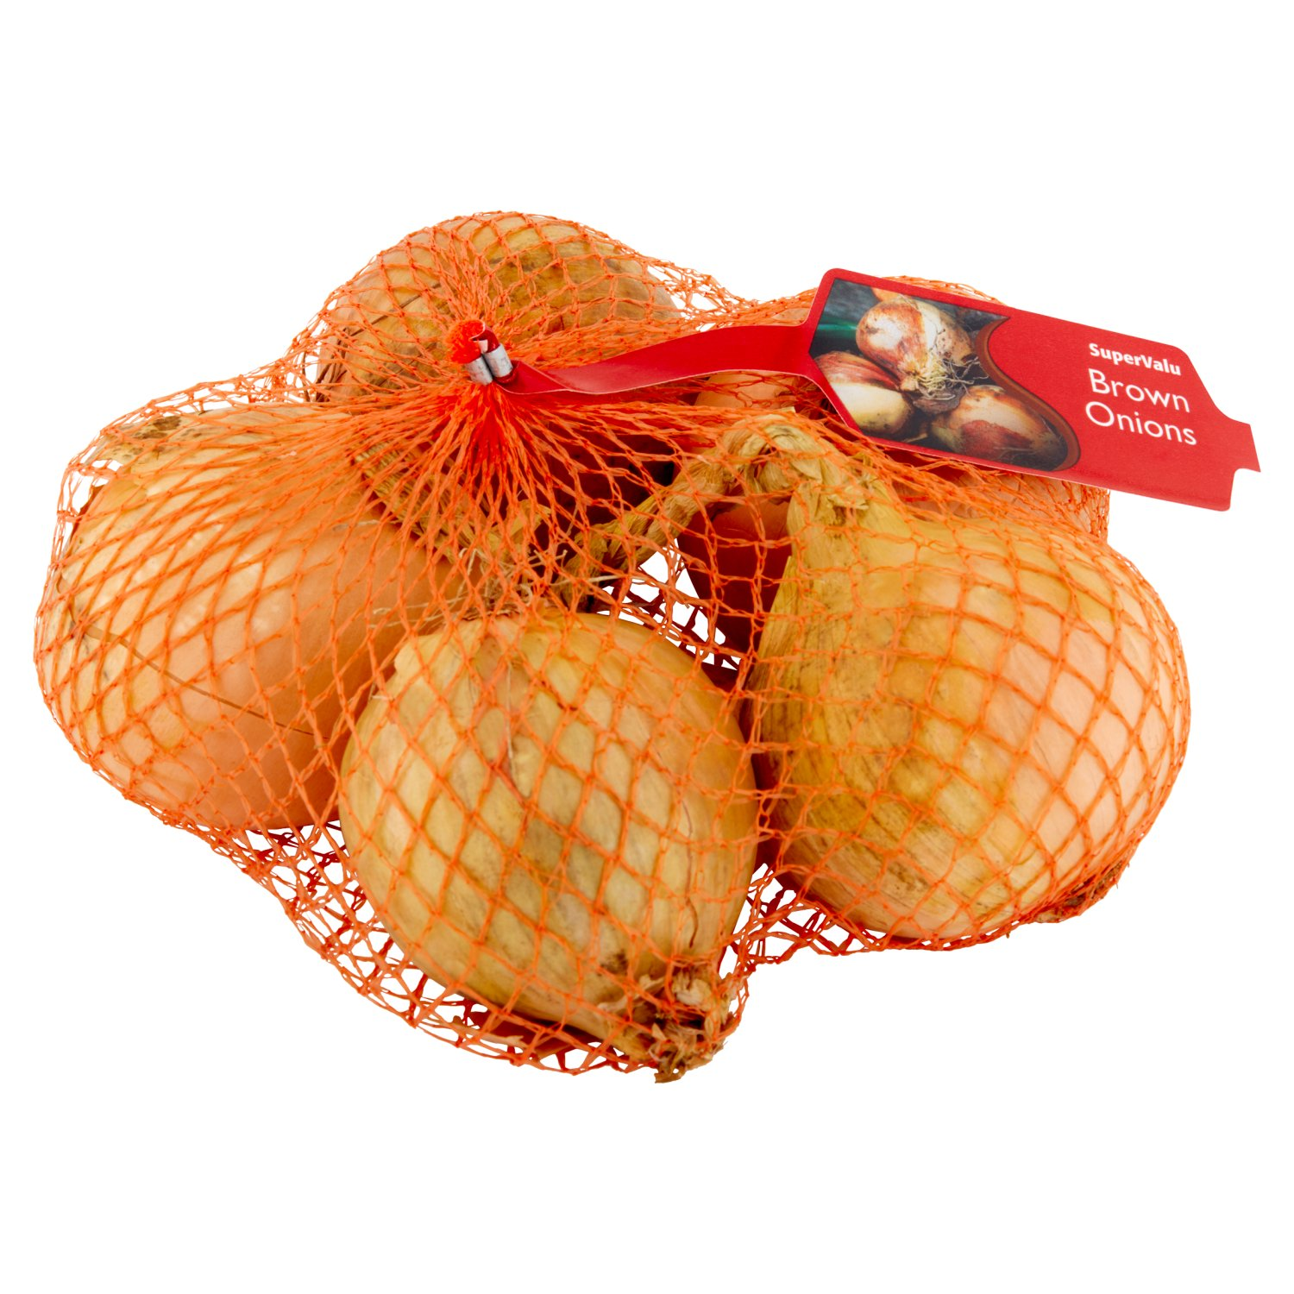
Old
Modern
Pick what you need
Check ripeness before you buy
7 Onions, Take it or leave it
Expire at different times

Slide 4
Take a picture of what ingredients you have on hand, and generate a recipe in a cuisine of your choosing
CookSmart: Leveraging Machine Learning and Object Detection for Culinary Exploration

Slide 5
Project Goals
Reduce Food Waste
Cook with what you have
Explore New Cuisines
Try something new
Grow Culinary Skills
Independence from CookBooks and online videos

Slide 6
System Overview
User Interface
Object Detection
Recipe Generator
Backend JS

Slide 7
Object Detection Model

Slide 8
YOLOv8
Image Segmentation
Divides the image into grid
Bounding Box Prediction
Plot coordinates of detected objects
Class Probability
Object Score for multiple objects in image
You Only Look Once

Slide 9
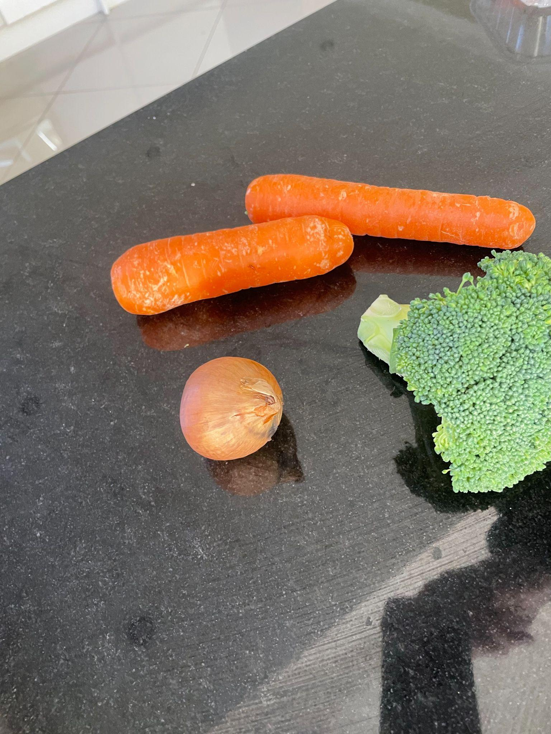
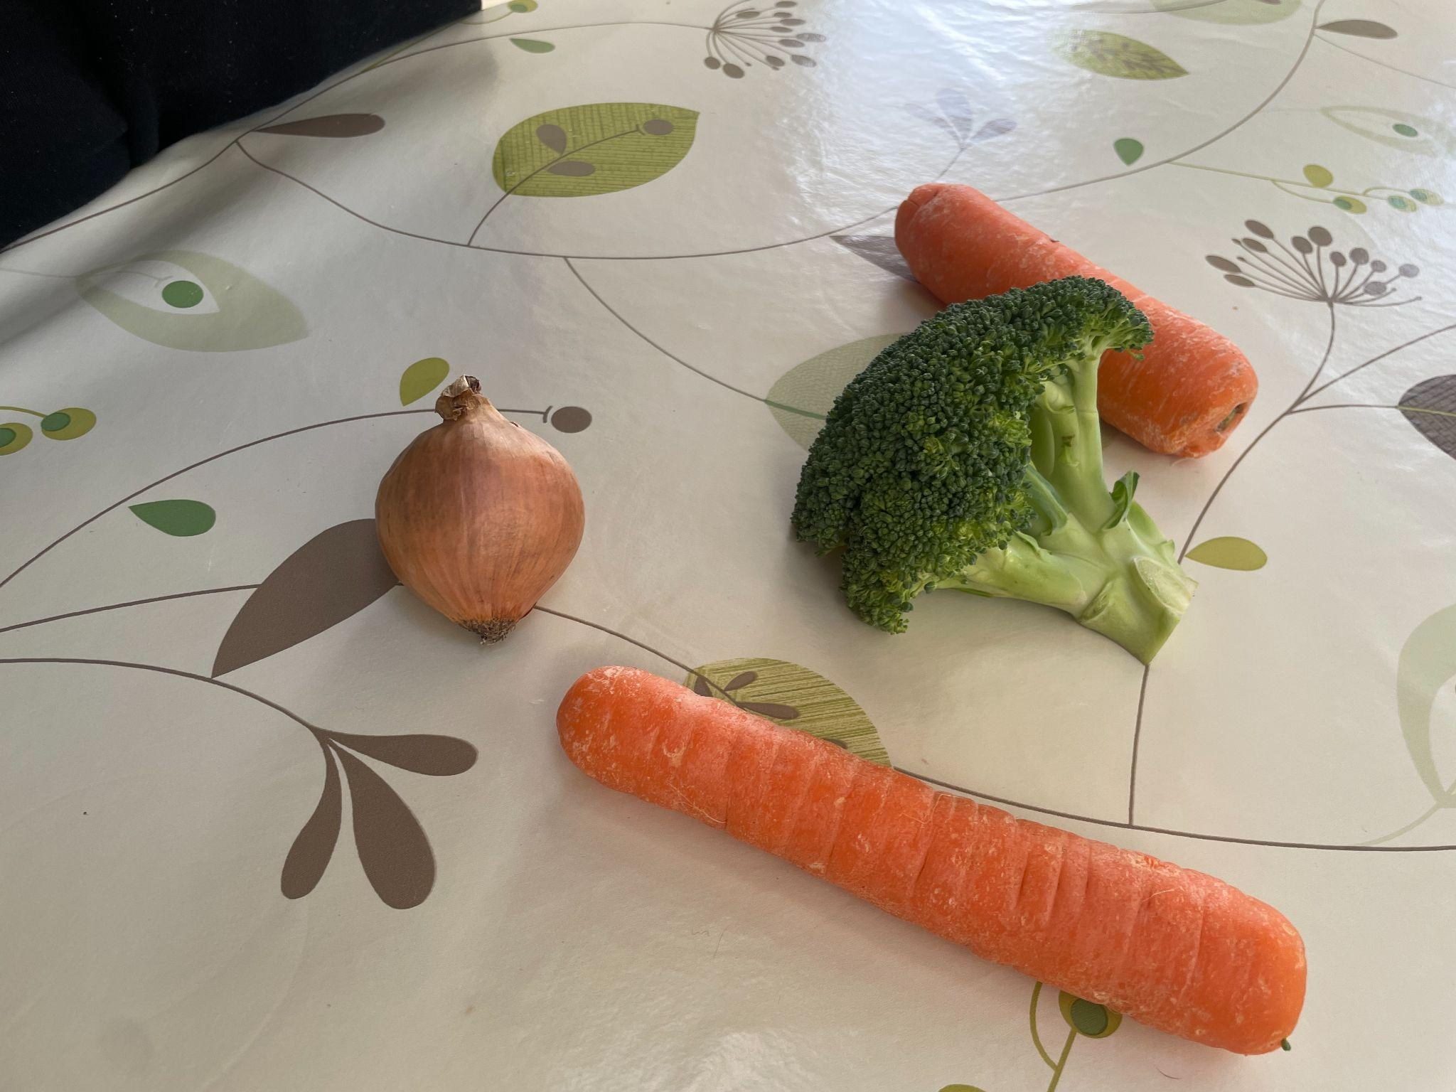
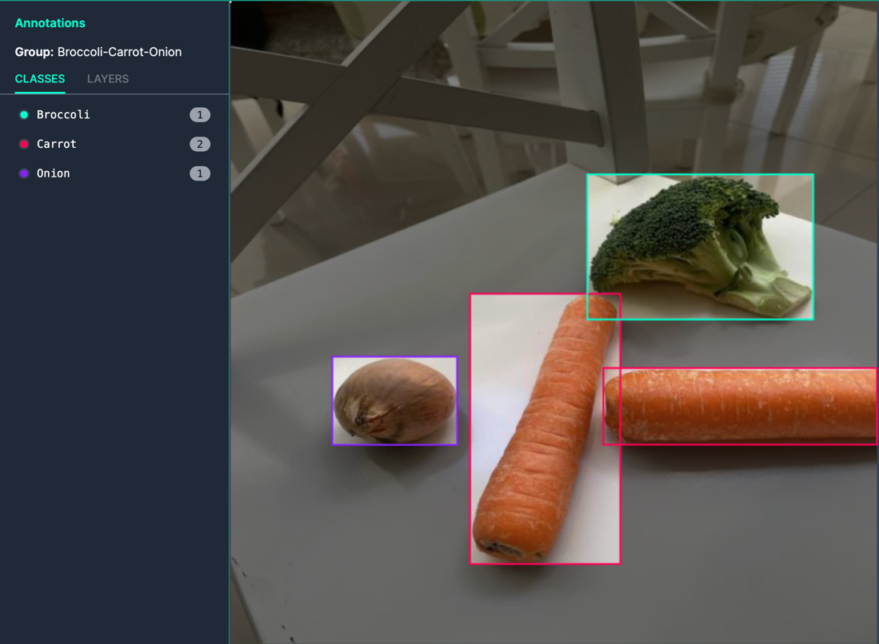
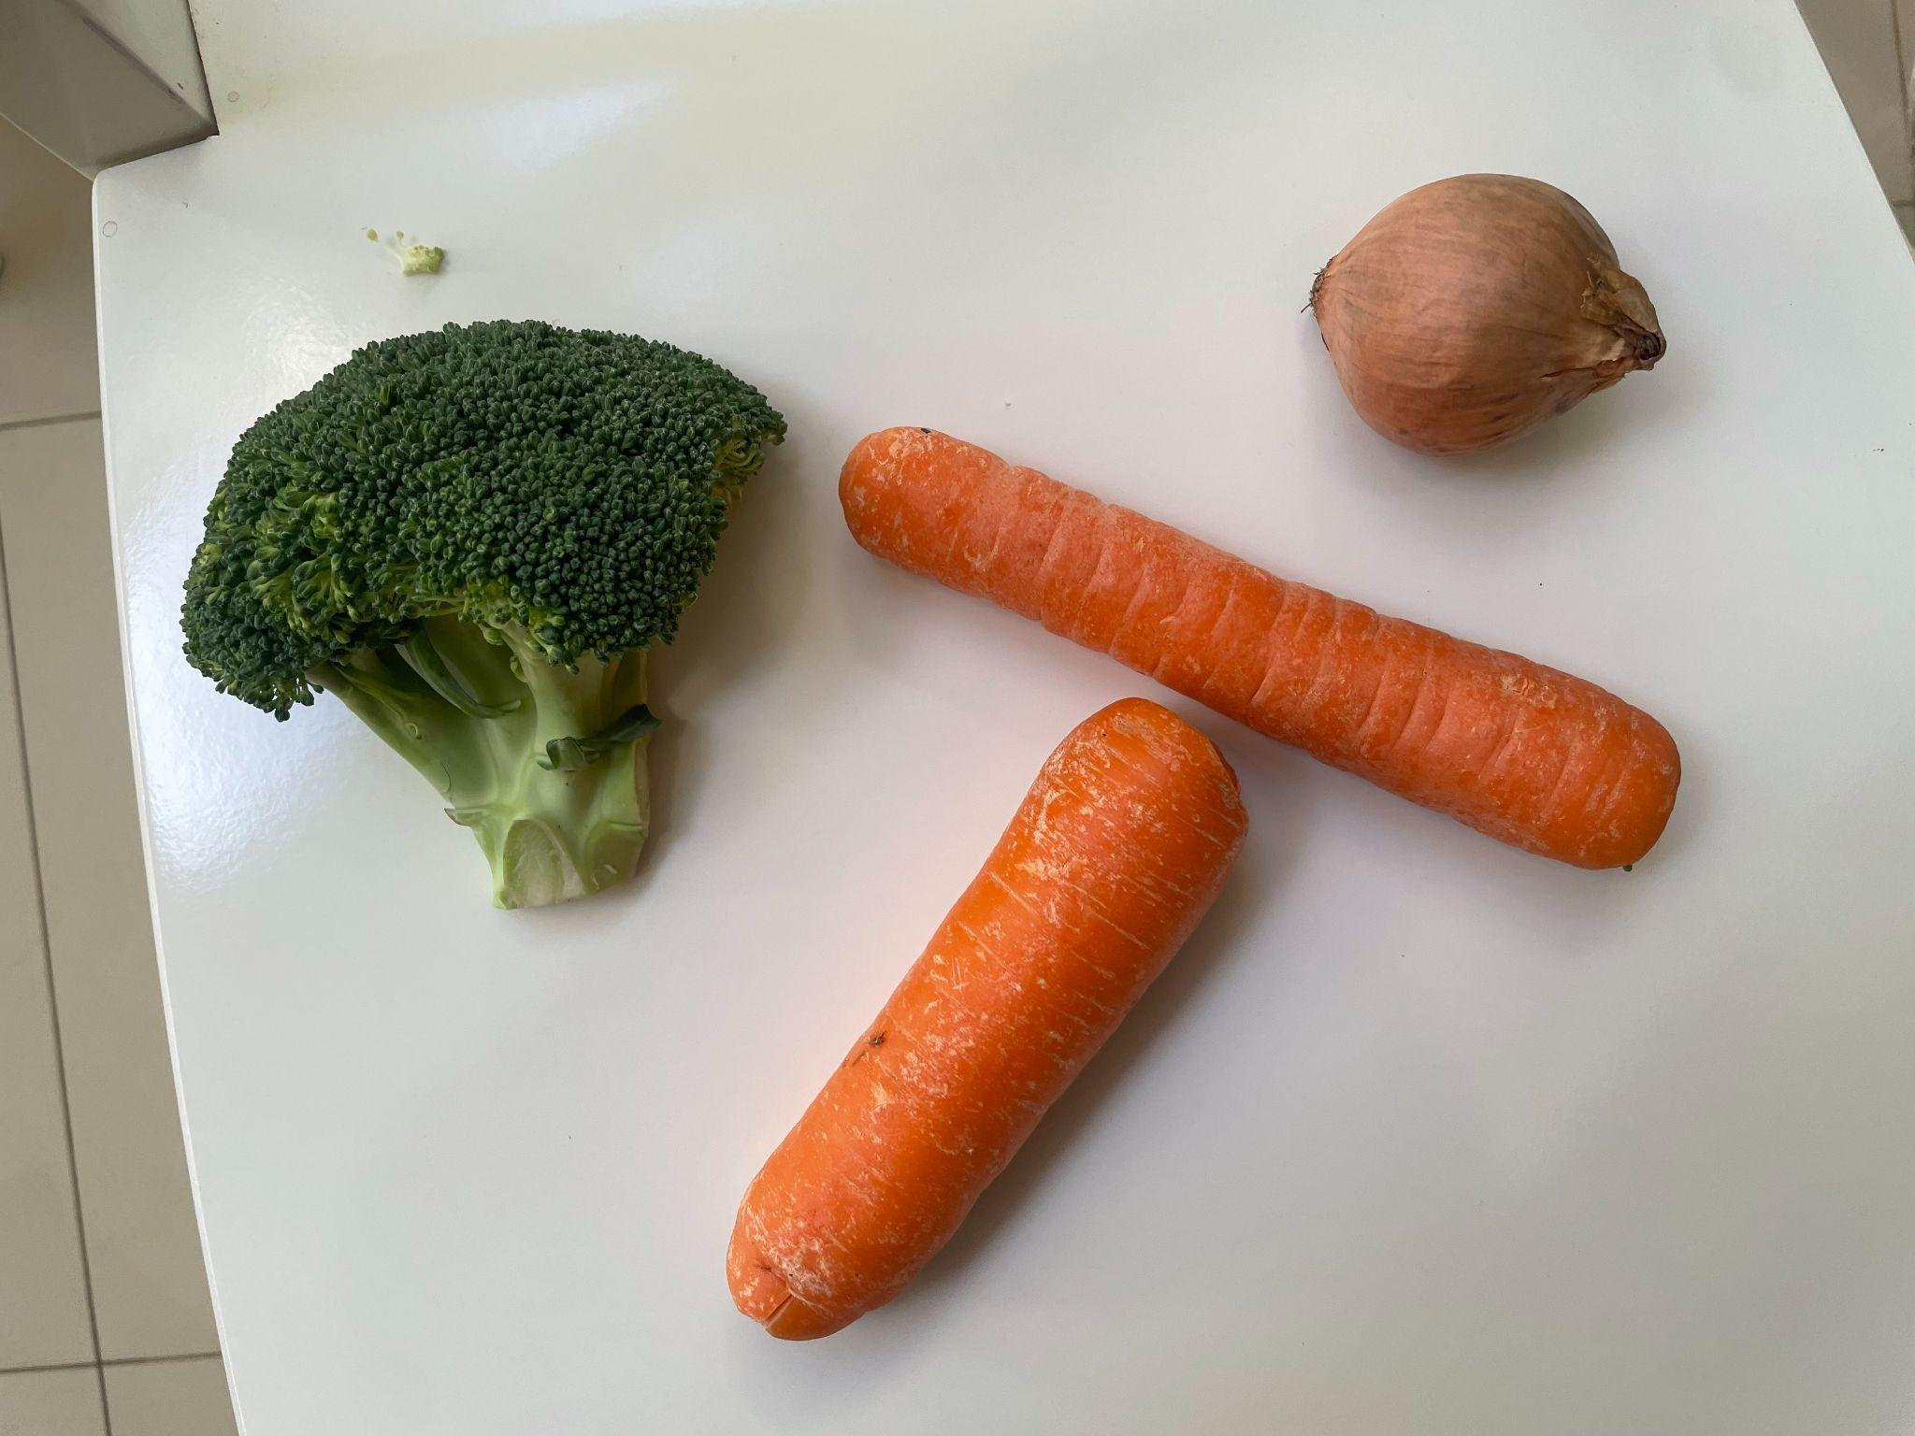
Image Acquisition
Image Annotation
Different Backgrounds
Alternate Angles
COCO Format
Time Consuming

Slide 10
Image Formatting
Train 80%
Teaching the model to recognize objects in images
Test 10%
Evaluates the performance on unseen data
Validate 10%
Validates the predictions against a control

Slide 11
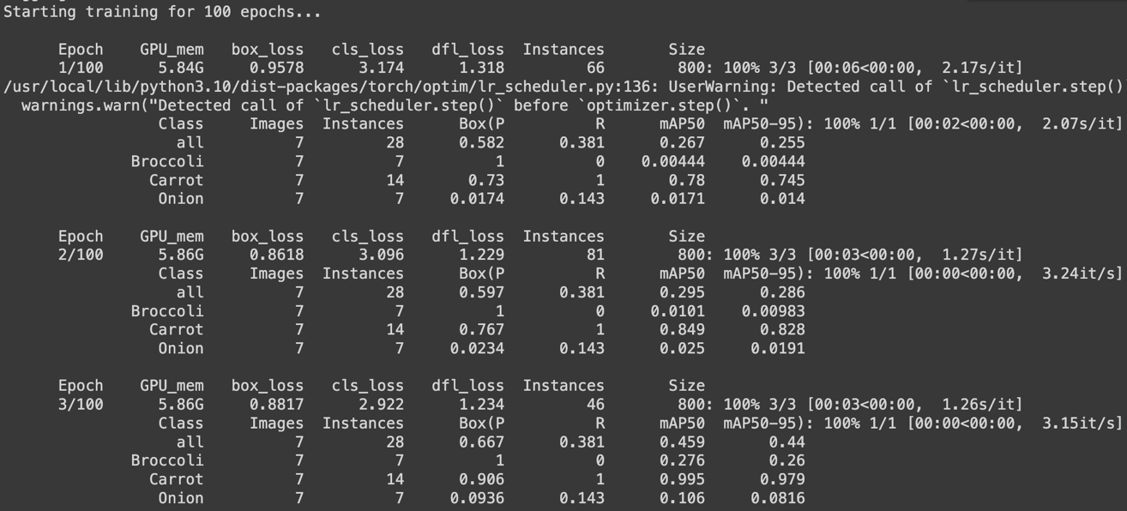
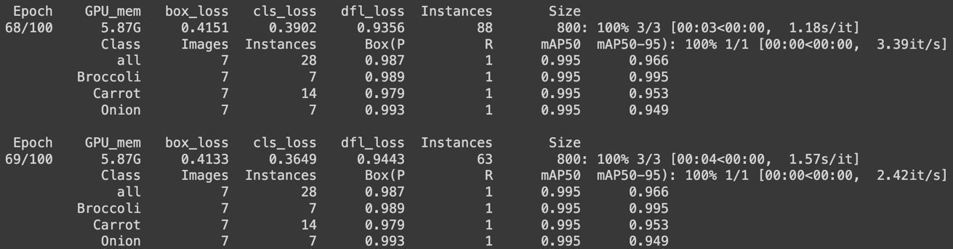
Training The Model
Improves With Each Epoch
Refines Accuracy to Predict Object in Different Contexts
Time Consuming with one GPU
Google Collab offers free GPU usage

Slide 12
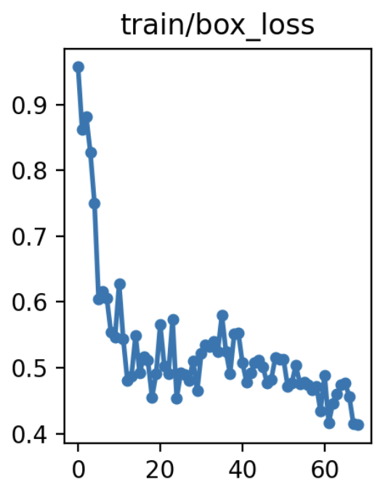
Box Loss
Disparity between predicted box and control box
Bounding Box Prediction
Plot coordinates of detected objects
Class Probability
Object Score for multiple objects in image

Slide 13
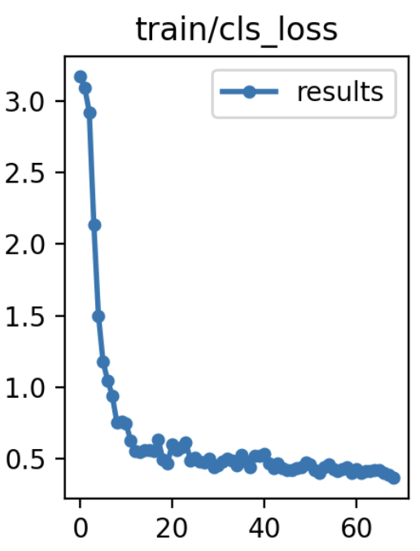
Classification Loss
Assesses the accuracy of classes detected in the image
How it works
Penalises the model for incorrect classification
Rewards the model for accurate ones

Slide 14
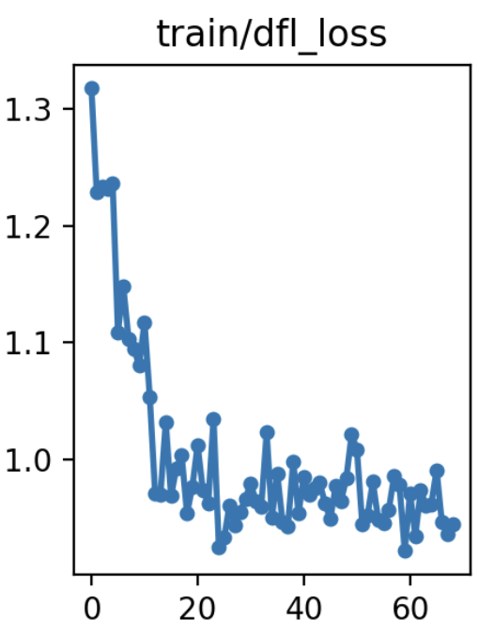
Dynamic Feature Loss
Adaptability to different features learned during training
Context
Refines ability to understand variations in an object
Application
Vegetables vary drastically in the real world

Slide 15
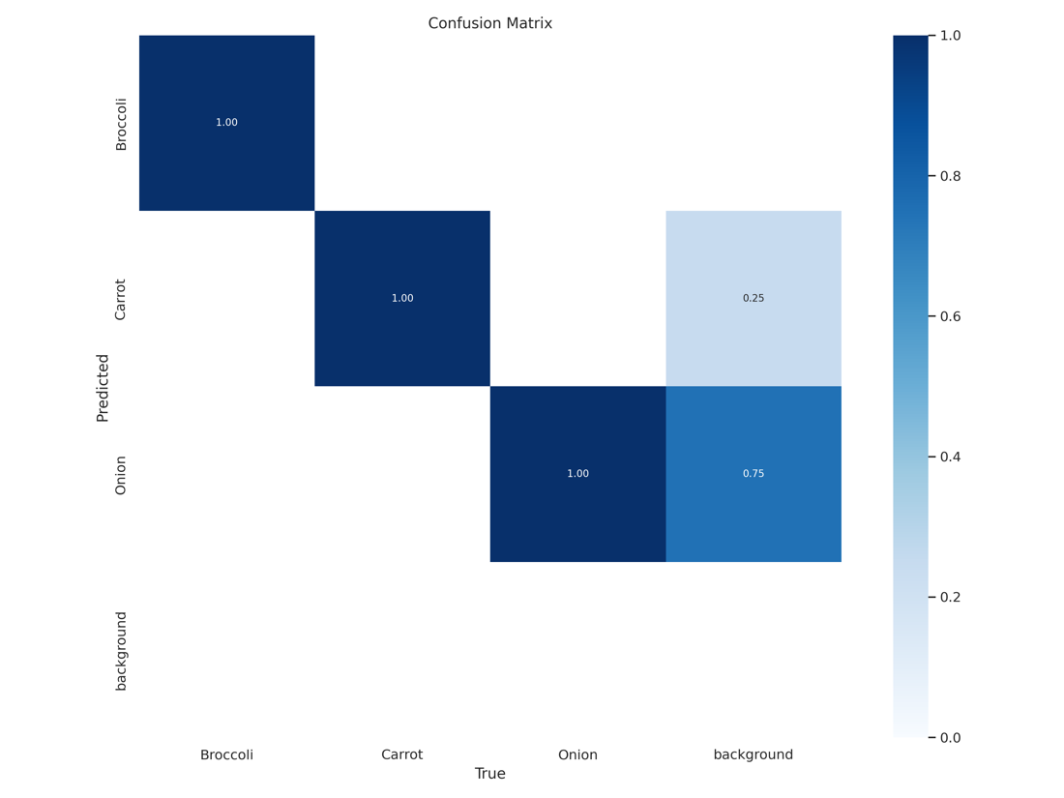
Confusion Matrix
Detects Objects Accurately
False Detections of background as onion or carrot
Mitigated with future training or weight adjustment

Slide 16
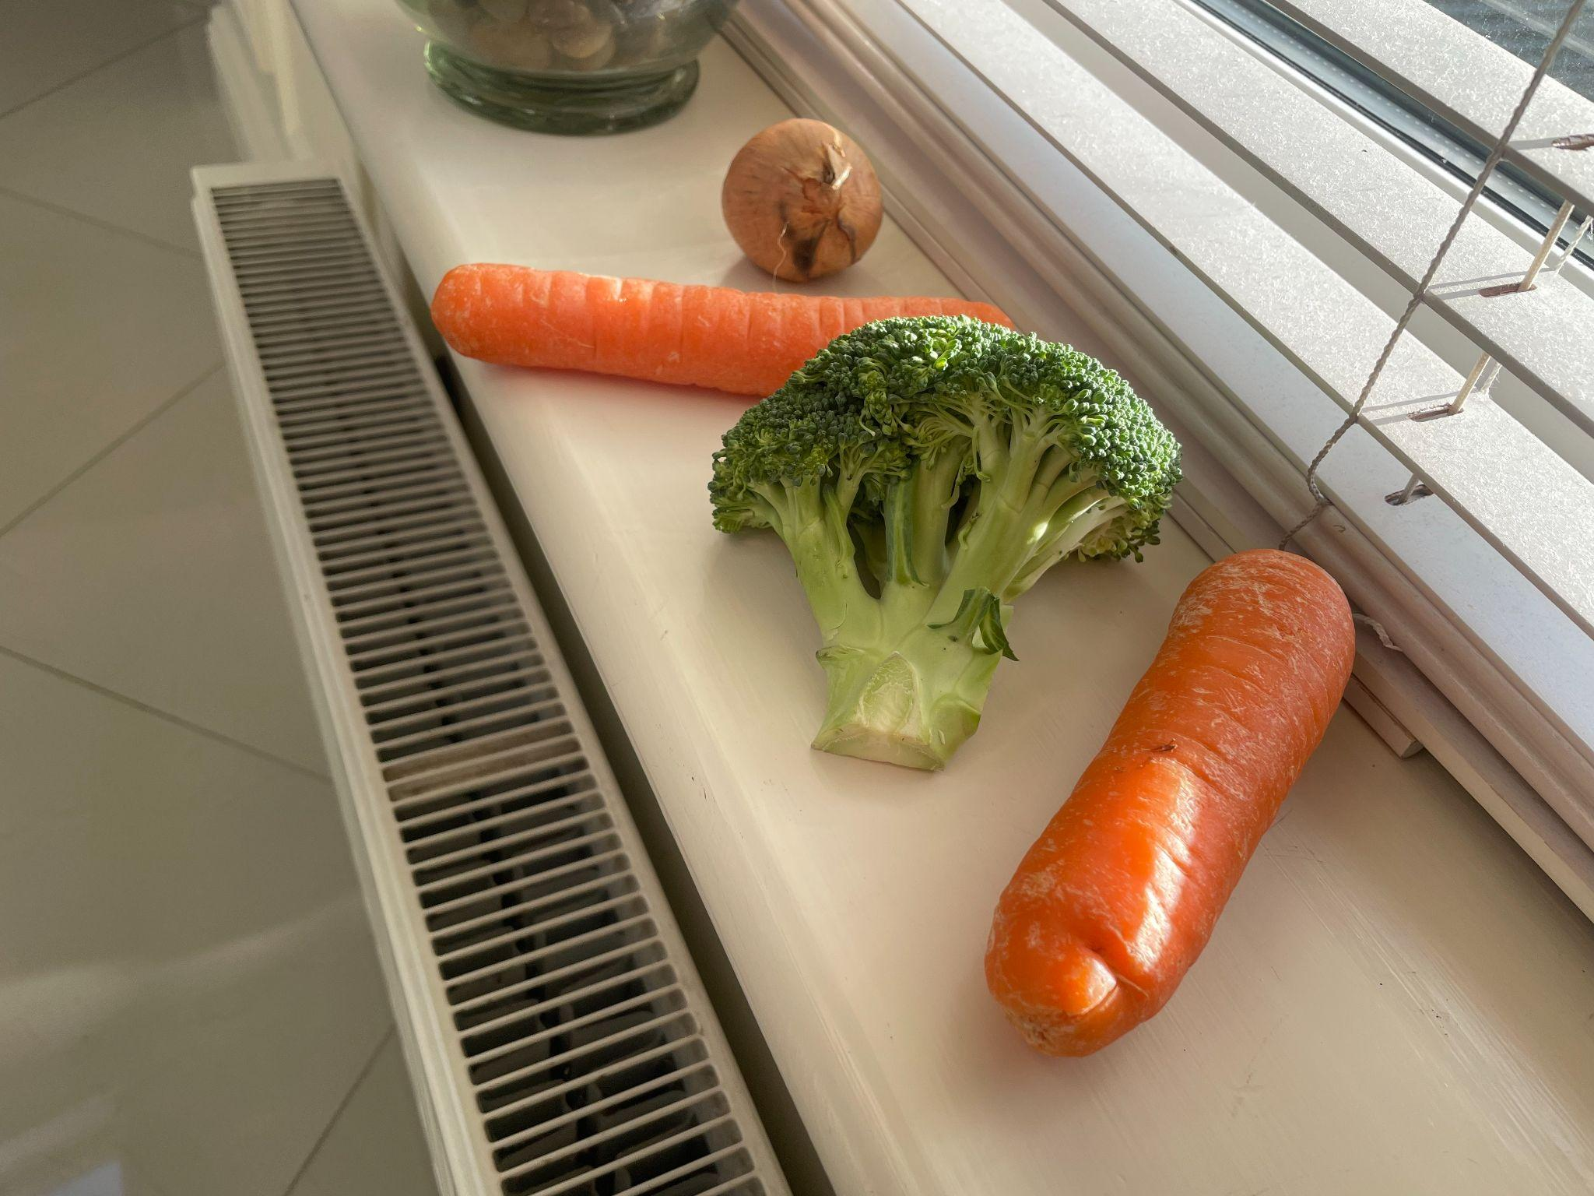

Input
Return
Image of Ingredients
Image of ingredients that have been identified and classified

Slide 17
Recipe Generator

Slide 18
Recipe Generator Requirements
Prompt Engineering
Must be able to take a custom prompt
Specified Output
Return recipe in specific format
Accuracy & Diversity
Must actually give recipe with in desired style

Slide 19

Chat GPT 2
Free To Use
Contextual Relevance
Limited Output
Boiled Vegetable Generator

Slide 20

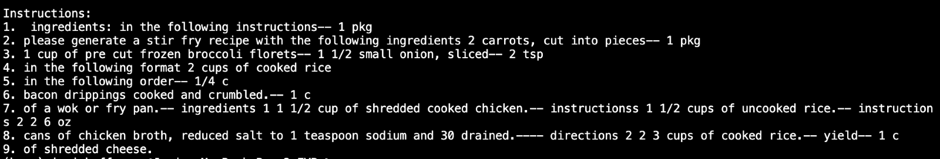
Google Flan-T5
Free to use
Text to Text Transformer
Stir Fry Generator

Slide 21

Chat GPT-3.5 Turbo
Contextual Relevance
Conversation Style
Specific Output
Supports different styles of cuisine
Costs per token

Slide 22
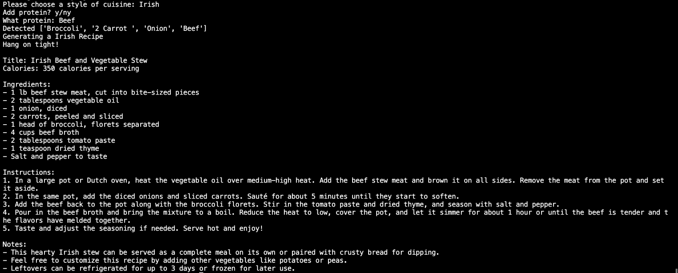
Chat GPT-3.5 Turbo

Slide 23
System Overview

Slide 24
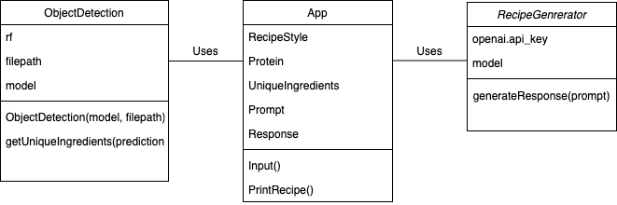
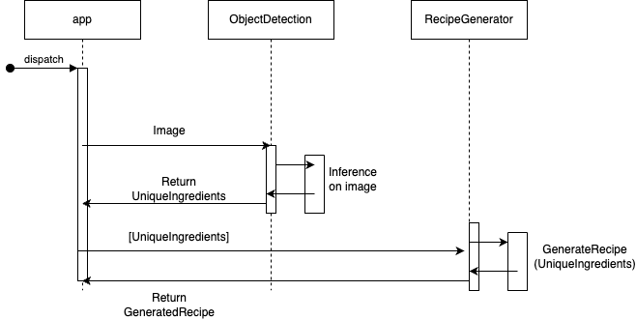
Class Diagram
Attributes & Methods of each
Both AI classes used by the main App class
Sequence Diagram
Low Coupling
AI’s do not talk directly to each other
Only interact through the main app file

Slide 25
Future Work
JSON Output
Restrict Recipe Generator to JSON output
Persistent Storage
Add database to the backend to store recipes
User Interface
Develop a Simple and Intuitive UI for seamless User Experience

Slide 26
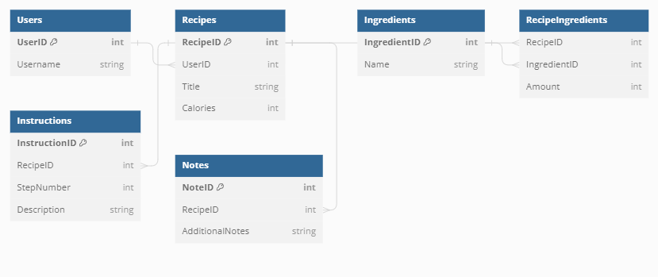
Database Schema

Slide 27
Demo

